Slide 1
Software Process Models

Slide 2
Iterative Model
In the Iterative model, iterative process starts with a simple implementation of a small set of the software requirements and iteratively enhances the evolving versions until the complete system is implemented and ready to be deployed.
An iterative life cycle model does not attempt to start with a full specification of requirements. Instead, development begins by specifying and implementing just part of the software, which is then reviewed to identify further requirements.
This process is then repeated, producing a new version of the software at the end of each iteration of the model.

Slide 3
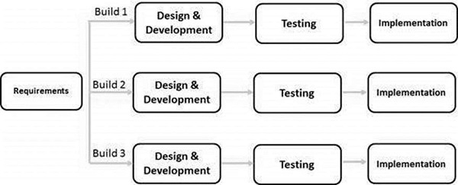

Slide 4
Iterative process starts with a simple implementation of a subset of the software requirements and iteratively enhances the evolving versions until the full system is implemented.
At each iteration, design modifications are made and new functional capabilities are added.
The basic idea behind this method is to develop a system through repeated cycles (iterative) and in smaller portions at a time (incremental).
In this incremental model, the whole requirement is divided into various builds.
During each iteration, the development module goes through the requirements, design, implementation and testing phases.
Each subsequent release of the module adds function to the previous release. The process continues till the complete system is ready as per the requirement.

Slide 5
Application
Requirements of the complete system are clearly defined and understood.
Major requirements must be defined; however, some functionalities or requested enhancements may evolve with time.
There is a time to the market constraint.
A new technology is being used and is being learnt by the development team while working on the project.
Resources with needed skill sets are not available and are planned to be used on contract basis for specific iterations.
There are some high-risk features and goals which may change in the future.

Slide 6
Advantages
Some working functionality can be developed quickly and early in the life cycle.
Results are obtained early and periodically.
Parallel development can be planned.
Progress can be measured.
Less costly to change the scope/requirements.
Testing and debugging during smaller iteration is easy.
Risks are identified and resolved during iteration; and each iteration is an easily managed milestone.
Easier to manage risk - High risk part is done first.
With every increment, operational product is delivered.
Issues, challenges and risks identified from each increment can be utilized/applied to the next increment.

Slide 7
Disadvantages
More resources may be required.
Although cost of change is lesser, but it is not very suitable for changing requirements.
More management attention is required.
System architecture or design issues may arise because not all requirements are gathered in the beginning of the entire life cycle.
Defining increments may require definition of the complete system.
Not suitable for smaller projects.
Management complexity is more.
End of project may not be known which is a risk.
Highly skilled resources are required for risk analysis.
Projects progress is highly dependent upon the risk analysis phase.

Slide 8
Spiral Model
The spiral model has four phases. A software project repeatedly passes through these phases in iterations called Spirals.
Identification
This phase starts with gathering the business requirements in the baseline spiral. In the subsequent spirals as the product matures, identification of system requirements, subsystem requirements and unit requirements are all done in this phase.
This phase also includes understanding the system requirements by continuous communication between the customer and the system analyst. At the end of the spiral, the product is deployed in the identified market.
Design
The Design phase starts with the conceptual design in the baseline spiral and involves architectural design, logical design of modules, physical product design and the final design in the subsequent spirals.
Construct or Build
The Construct phase refers to production of the actual software product at every spiral. In the baseline spiral, when the product is just thought of and the design is being developed a POC (Proof of Concept) is developed in this phase to get customer feedback.

Slide 9
Then in the subsequent spirals with higher clarity on requirements and design details a working model of the software called build is produced with a version number. These builds are sent to the customer for feedback.
Evaluation and Risk Analysis
Risk Analysis includes identifying, estimating and monitoring the technical feasibility and management risks, such as schedule slippage and cost overrun. After testing the build, at the end of first iteration, the customer evaluates the software and provides feedback.

Slide 10
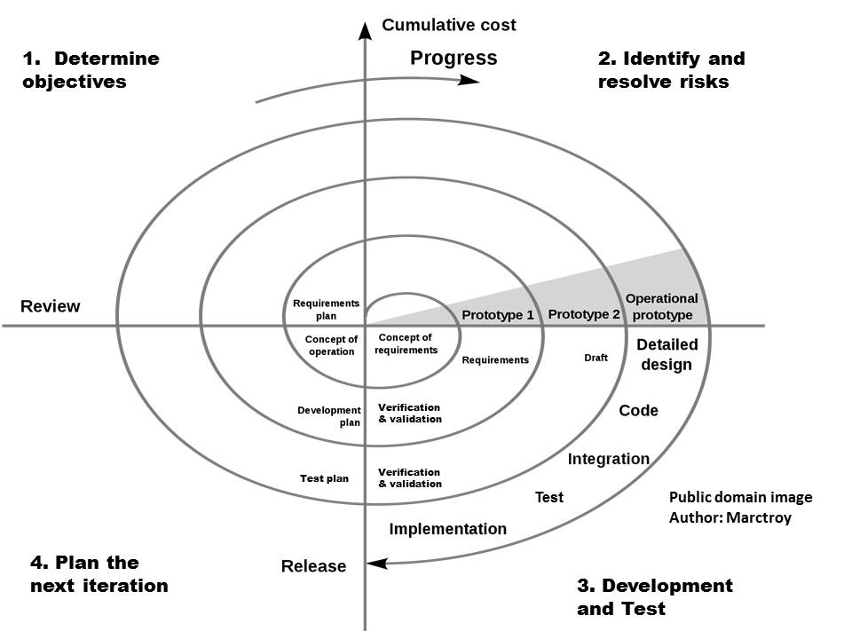

Slide 11
Applications
When there is a budget constraint and risk evaluation is important.
For medium to high-risk projects.
Long-term project commitment because of potential changes to economic priorities as the requirements change with time.
Customer is not sure of their requirements which is usually the case.
Requirements are complex and need evaluation to get clarity.
New product line which should be released in phases to get enough customer feedback.
Significant changes are expected in the product during the development cycle.

Slide 12
Advantages
Changing requirements can be accommodated.
Allows extensive use of prototypes.
Requirements can be captured more accurately.
Users see the system early.
Development can be divided into smaller parts and the risky parts can be developed earlier which helps in better risk management.

Slide 13
Disadvantages
Management is more complex.
End of the project may not be known early.
Not suitable for small or low risk projects and could be expensive for small projects.
Process is complex
Spiral may go on indefinitely.
Large number of intermediate stages requires excessive documentation.

Slide 14
V-Model
Under the V-Model, the corresponding testing phase of the development phase is planned in parallel. So, there are Verification phases on one side of the ‘V’ and Validation phases on the other side.
The Coding Phase joins the two sides of the V-Model.

Slide 15
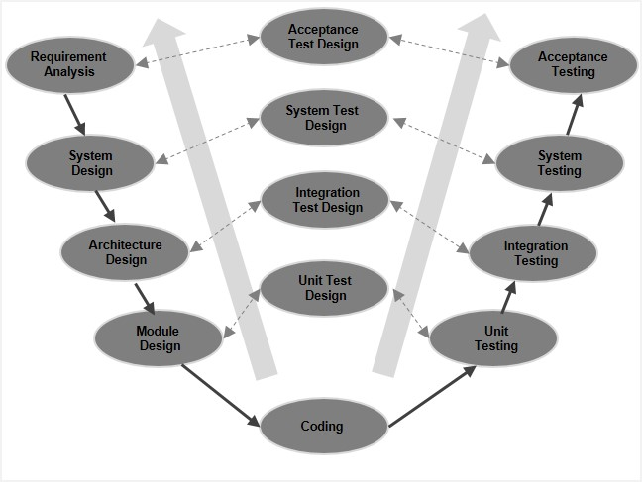

Slide 16
V-Model - Verification Phases
Business Requirement Analysis
This is the first phase in the development cycle where the product requirements are understood from the customer’s perspective. This phase involves detailed communication with the customer to understand his expectations and exact requirement. This is a very important activity and needs to be managed well, as most of the customers are not sure about what exactly they need. The acceptance test design planning is done at this stage as business requirements can be used as an input for acceptance testing.
System Design
Once you have the clear and detailed product requirements, it is time to design the complete system. The system design will have the understanding and detailing the complete hardware and communication setup for the product under development. The system test plan is developed based on the system design. Doing this at an earlier stage leaves more time for the actual test execution later.

Slide 17
Architectural Design
Architectural specifications are understood and designed in this phase. Usually more than one technical approach is proposed and based on the technical and financial feasibility the final decision is taken. The system design is broken down further into modules taking up different functionality. This is also referred to as High Level Design (HLD).
The data transfer and communication between the internal modules and with the outside world (other systems) is clearly understood and defined in this stage. With this information, integration tests can be designed and documented during this stage.
Module Design
In this phase, the detailed internal design for all the system modules is specified, referred to as Low Level Design (LLD). It is important that the design is compatible with the other modules in the system architecture and the other external system.

Slide 18
The unit tests are an essential part of any development process and helps eliminate the maximum faults and errors at a very early stage. These unit tests can be designed at this stage based on the internal module designs.

